Slide 1
IBM University Engagement Project Submission
“Exploring the Power of Agentic AI”

Slide 2

Project Tile – Travel Intelligence AI
Domain of Project – Travel & Tourism
Student Name | Recent Passport Photo | Email ID | Mobile number [WhatsApp]
Haseena Rahaman |  | haseenar2104@gmail.com | 6303032387

Slide 3
Problem Statement -
Problem Statement : Travel Intelligence AI
The Challenge
Planning a trip can be time-consuming and overwhelming. Travelers often need to search multiple websites for destinations, transportation, accommodation, attractions, and budgeting. Managing expenses while creating a well-balanced itinerary is difficult, especially for families, groups, and budget-conscious travellers. Traditional travel planning methods lack personalized recommendations and require significant manual effort.
The Objective
To develop an AI-powered Travel Intelligence application that simplifies trip planning by generating personalized travel itineraries and optimizing travel budgets based on user preferences. The solution leverages IBM watsonx Orchestrate to provide intelligent recommendations, helping users save time, manage expenses efficiently, and make informed travel decisions through a single, user-friendly platform.

Slide 4
Proposed Solution -
Proposed Solution: TraveI Intelligence AI
The proposed solution is an AI-powered Travel Intelligence application built using IBM watsonx Orchestrate, IBM Cloud, Python, and Streamlit to provide personalized travel planning and intelligent budget optimization.
the solution uses an IBM watsonx Orchestrate AI agent that understands user preferences and generates context-aware travel recommendations. The application securely communicates with the AI agent using IBM Identity and Access Management (IAM) authentication, ensuring secure and reliable access to IBM Cloud services.
The system consists of two key AI-powered modules:
AI Travel Planner: Generates a personalized day-wise travel itinerary based on the user’s input for attractions, accommodation, and transportation.
AI Budget Optimizer: Analyzes the user's travel details to provide an optimized budget allocation

Slide 5
The application features a user-friendly Streamlit interface that interacts with IBM watsonx Orchestrate to generate AI-powered recommendations in real time. IBM Cloud provides a secure and scalable platform for deploying the intelligent travel assistant.
Overall, Travel Intelligence AI simplifies trip planning by delivering personalized itineraries and intelligent budget optimization through a single AI-powered platform.

Slide 6
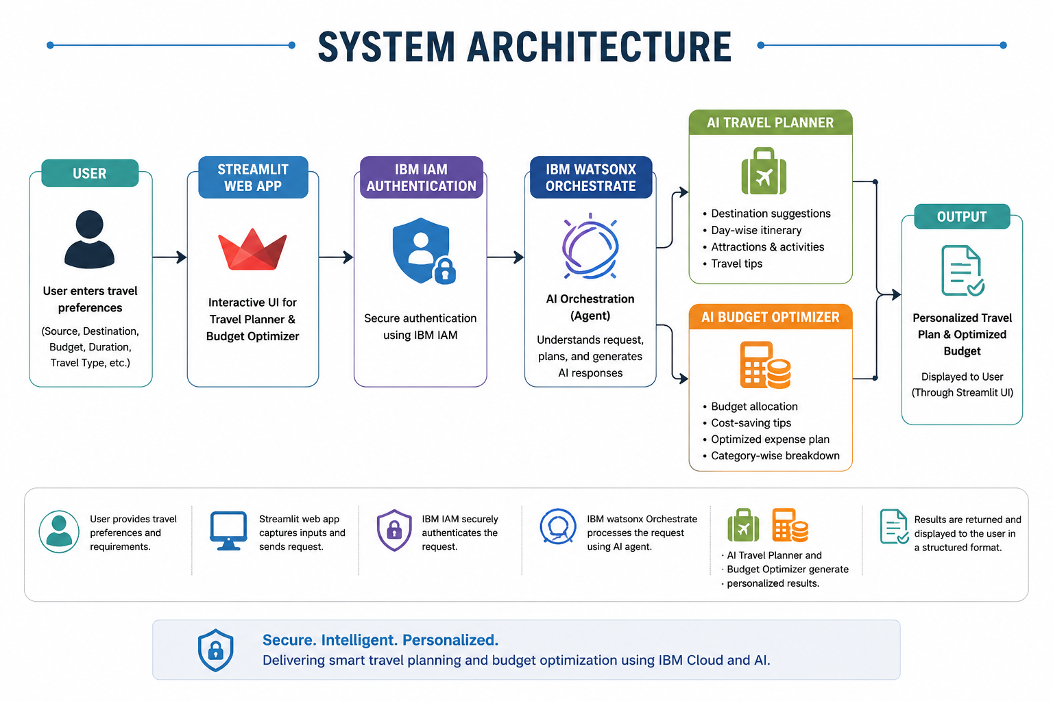

Slide 7
Workflow Steps
User Accesses the Application- The user launches the Streamlit-based Travel Intelligence AI application and selects either AI Travel Planner or AI Budget Optimizer.
User Inputs Travel Details- The user enters essential travel information such as the source location, destination, trip duration, budget, number of travelers, travel type, and travel interests.
Input Validation & Authentication- The application validates the entered information and securely authenticates the request using IBM Identity and Access Management (IAM).
Request Processing- The validated request is sent to the IBM watsonx Orchestrate AI Agent, which analyzes the user's travel requirements and context.
AI Recommendation Generation- Based on the selected feature, the AI agent either generates a personalized day-wise travel itinerary or provides an optimized travel budget with cost-saving recommendations.
Display of Results- The generated travel plan or budget optimization report is displayed on the Streamlit interface in a structured and easy-to-read format.
User Review & Planning- The user can review the recommendations and use them to make informed travel decisions and plan the trip more efficiently.

Slide 8
Technology Used
IBM watsonx Orchestrate- Used to build and deploy the AI agent that generates personalized travel itineraries and budget optimization recommendations.
IBM Cloud- Provides a secure and scalable cloud platform for hosting and managing the Travel Intelligence AI application.
REST APIs (Requests Library)- Used to securely communicate with IBM watsonx Orchestrate and retrieve AI-generated responses.
Python– The core programming language used to develop the application and integrate IBM Cloud services.
Streamlit- Used to build the interactive web interface for the AI Travel Planner and Budget Optimizer.
IBM Identity and Access Management (IAM)– Used for secure authentication and authorization between the Streamlit application and IBM watsonx Orchestrate APIs.
Python Dotenv (.env)- Used to securely store sensitive credentials such as API keys, URLs, and Agent ID.

Slide 9
Role of Agentic AI in the solution
The IBM watsonx Orchestrate AI agent serves as the intelligent core of the Travel Intelligence AI application. It autonomously understands user travel requirements, analyzes multiple travel parameters, and generates personalized recommendations in real time.
Instead of following predefined rules, the AI agent interprets the user's preferences and provides context-aware responses, making travel planning more efficient, personalized, and user-friendly.
Responsibilities of the AI Agent:
Understands user inputs such as source, destination, budget, duration, travel type, and travel interests.
Generates personalized day-wise travel itineraries tailored to user preferences.
Optimizes travel budgets by recommending efficient budget allocation and cost-saving strategies. Provides intelligent travel suggestions, including attractions, transportation, accommodation, packing tips, and safety guidelines.
Automates the travel planning process, reducing manual effort and improving decision-making.

Slide 10
IBM Components Used-
IBM watsonx Orchestrate – AI agent used to generate personalized travel itineraries and budget optimization recommendations.
IBM Identity and Access Management (IAM) - Authenticates API requests securely and manages access to IBM Cloud services.
IBM Cloud- Provides the cloud environment for hosting and managing IBM AI services.

Slide 11
Key Features of the Application
AI Travel Planner
Generates personalized day-wise travel itineraries based on user preferences.
Recommends tourist attractions, accommodation, transportation, local food, and travel tips.
Provides estimated travel expenses, packing suggestions, and safety guidelines for a complete travel experience.
AI Budget Optimizer
Creates an optimized travel budget based on the user's destination, duration, and budget.
Suggests cost-saving strategies, economical transportation, and accommodation options.
Allocates expenses across travel, stay, food, sightseeing, and miscellaneous costs while highlighting hidden expenses and providing an overall budget assessment.
Additional Features
Interactive and user-friendly Streamlit interface.
Secure API communication using IBM IAM Authentication.
AI-powered recommendations through IBM watsonx Orchestrate.
Fast and personalized travel planning in real time.

Slide 12
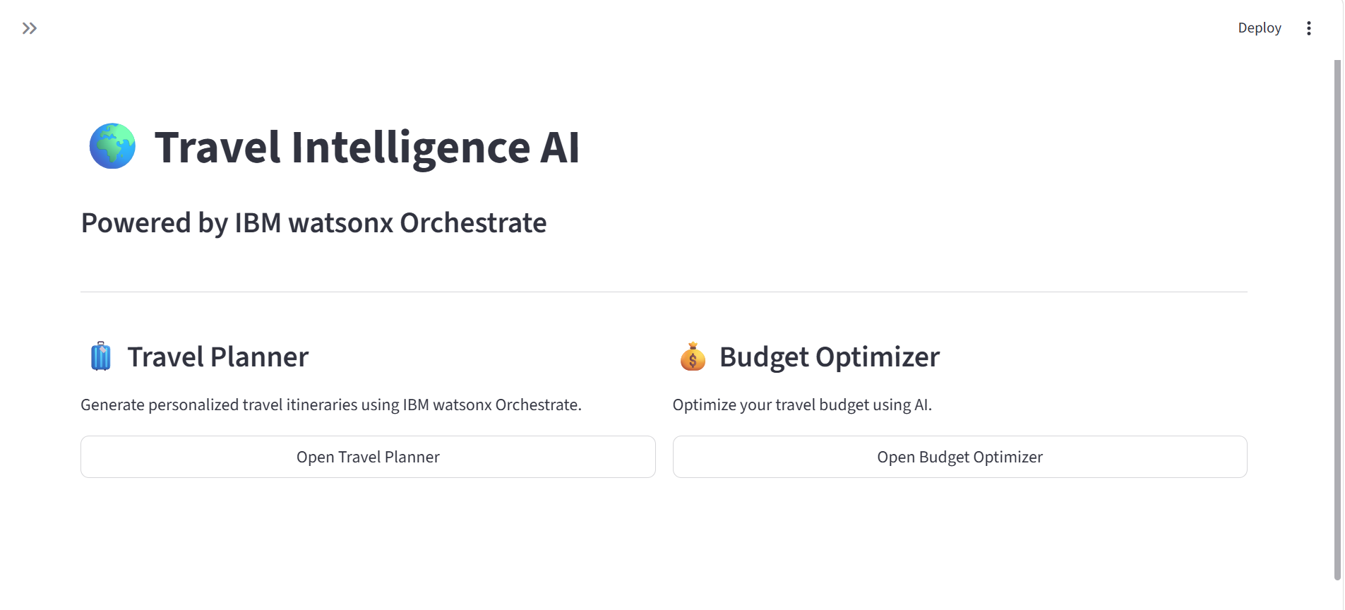
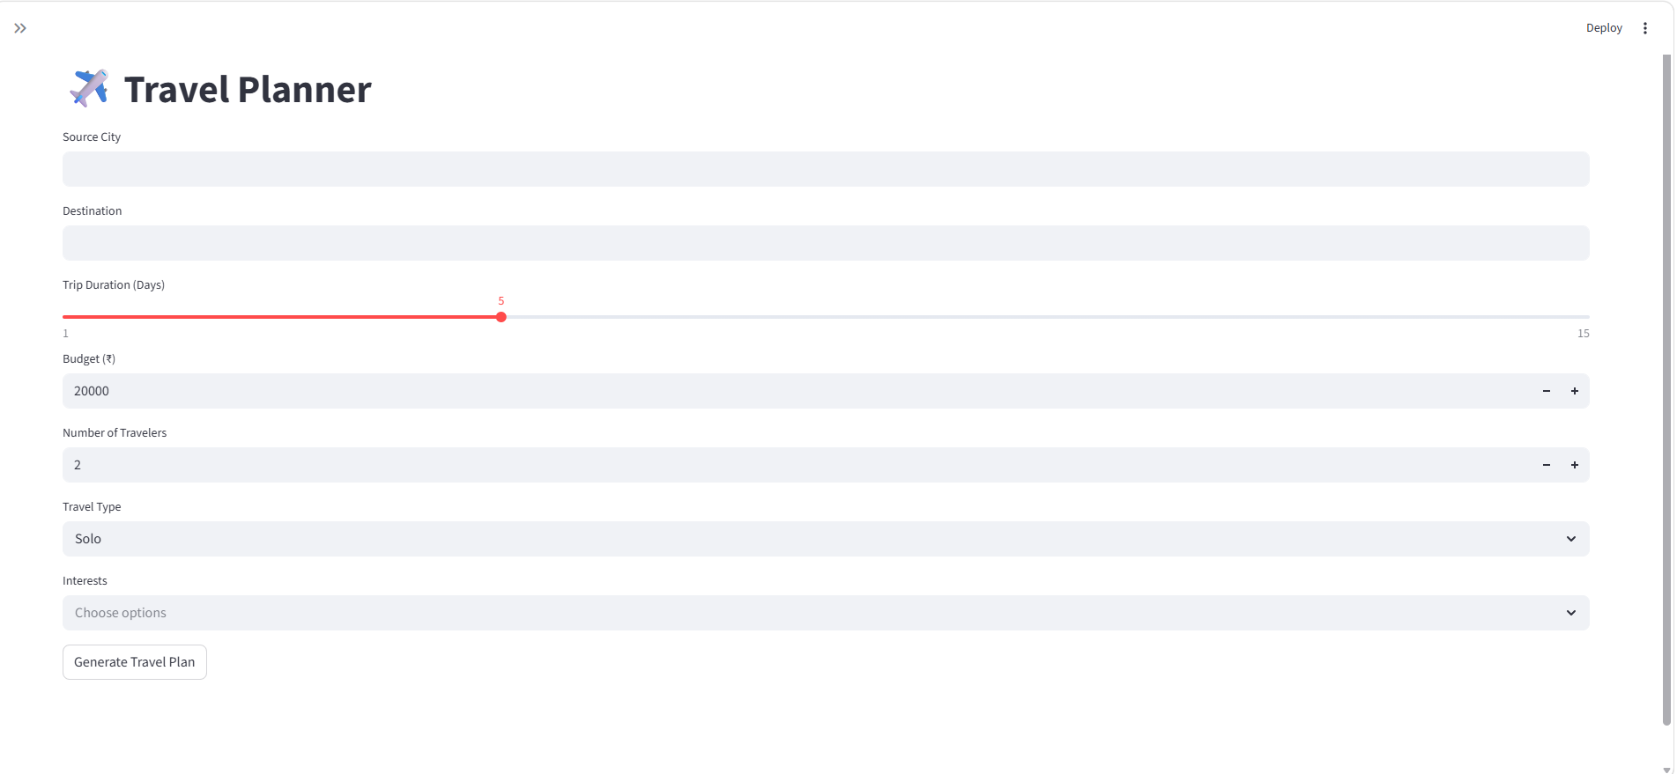
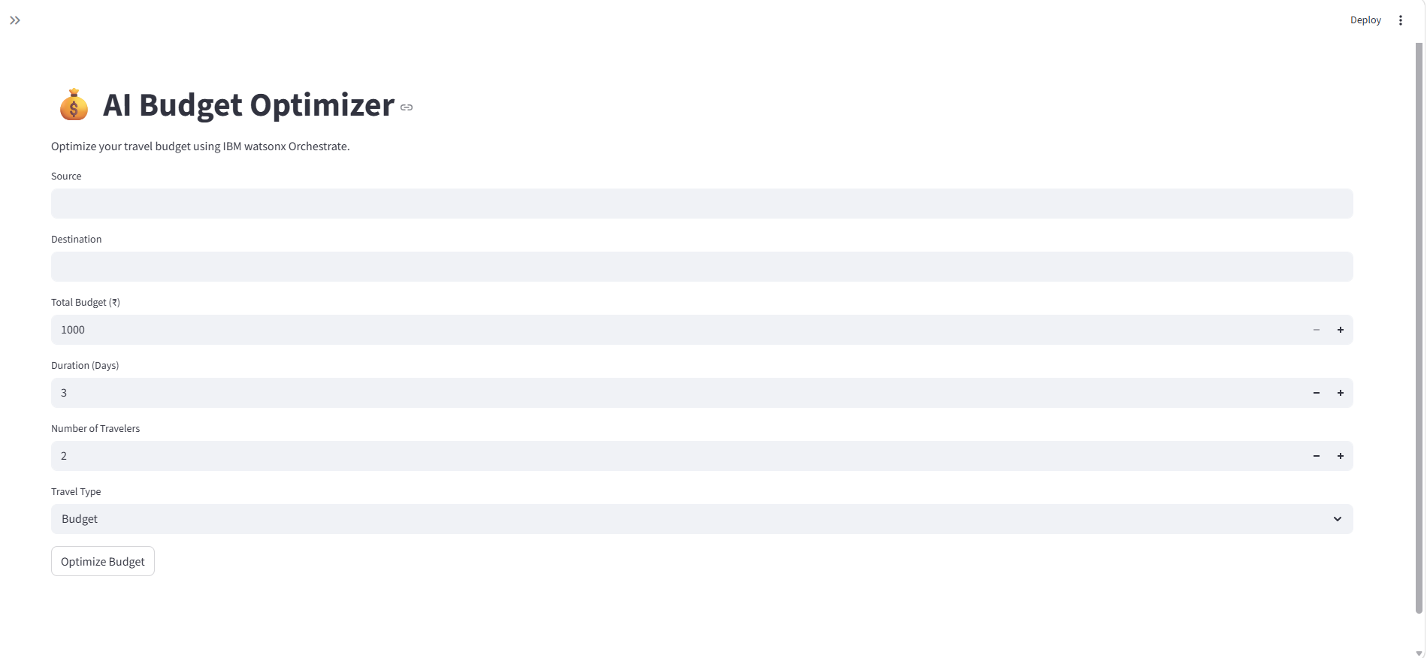
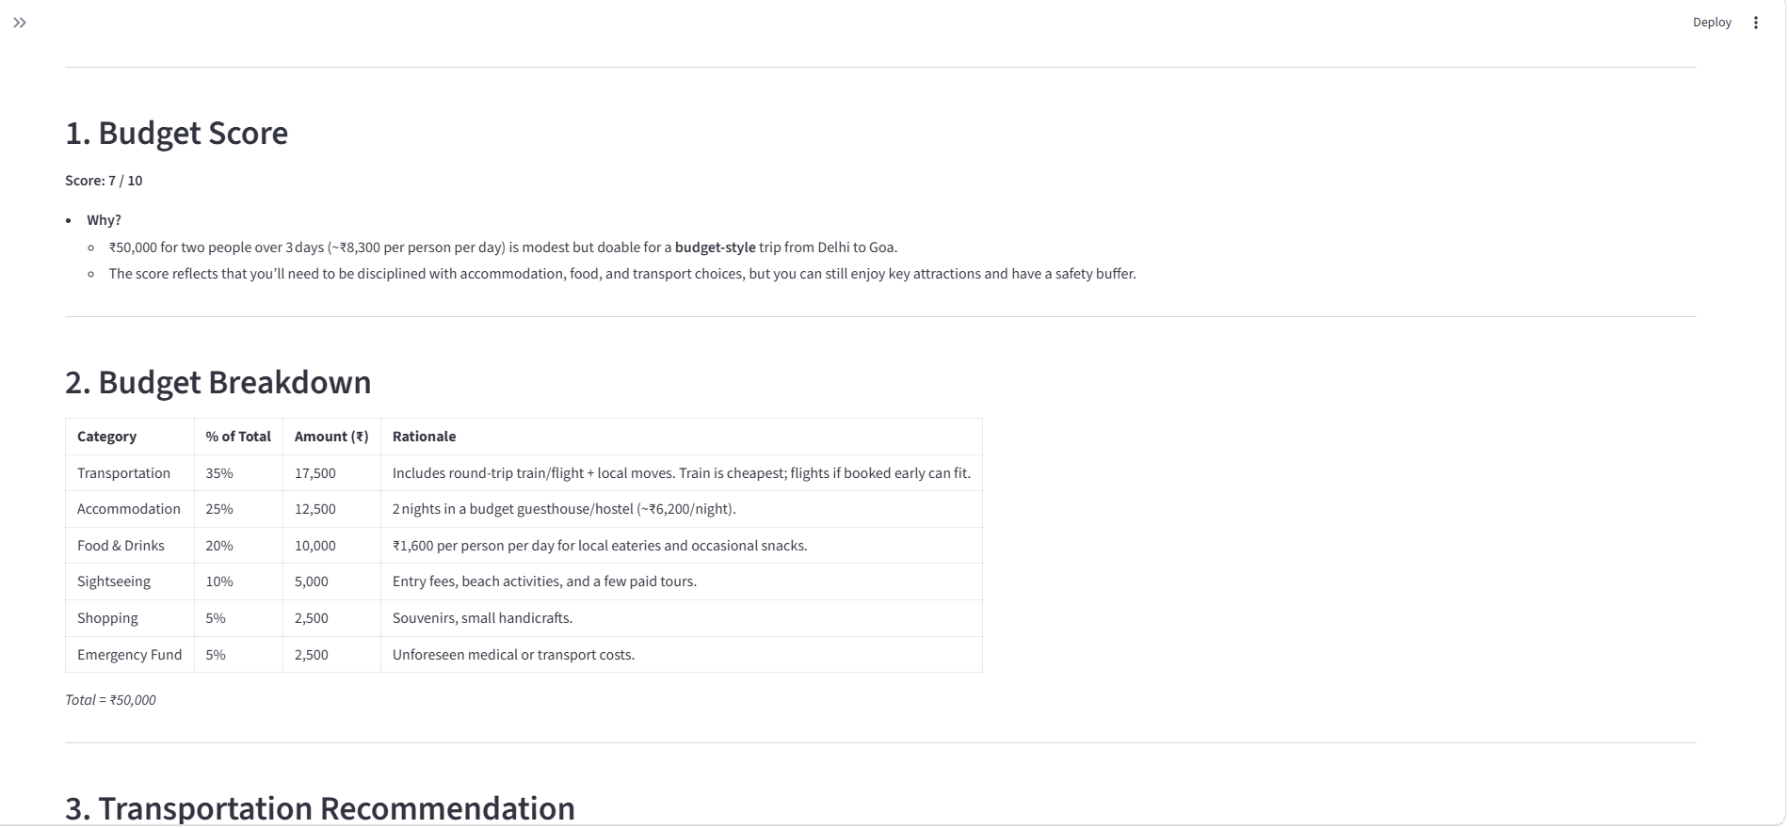
Application screenshots

Slide 13
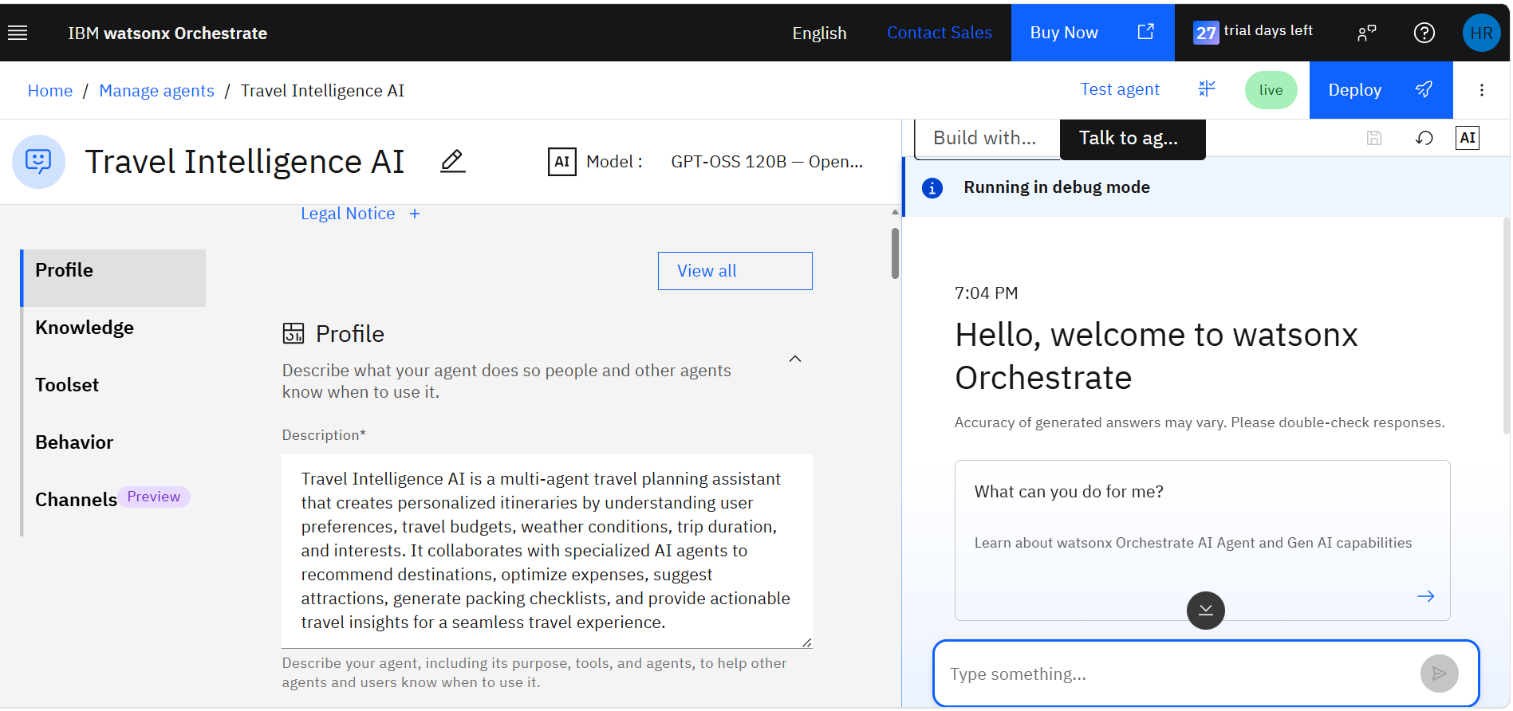

Slide 14
Results Achieved
The Travel Intelligence AI application successfully generates personalized travel recommendations and budget optimization reports based on user preferences using IBM watsonx Orchestrate.
Key Outcomes
✅ Generates personalized day-wise travel itineraries.
✅ Provides optimized budget allocation for transportation, accommodation, food, and sightseeing.
✅ Suggests suitable tourist attractions and travel recommendations.
✅ Recommends economical travel options and cost-saving tips.
✅ Displays AI-generated results in real time through an interactive Streamlit interface.
✅ Simplifies travel planning while improving user decision-making.

Slide 15
Sample Output
AI Travel Planner
5-day personalized itinerary
Tourist attractions
Hotel recommendations
Transportation suggestions
Estimated trip cost
Packing checklist
Safety guidelines
AI Budget Optimizer
Budget allocation by category
Cost-saving recommendations
Hidden expense alerts
Budget summary
Overall Budget Score

Slide 16
Future Scope
Although the current system provides AI-powered travel planning and budget optimization, several enhancements can be implemented to improve functionality and user experience.
Proposed Enhancements
Hotel & Flight Booking Integration – Enable users to directly book hotels, flights, and transportation from the application.
Real-Time Weather Updates – Integrate weather APIs to provide destination-specific forecasts and travel alerts.
Interactive Maps & Navigation – Display routes, nearby attractions, and locations using Google Maps or IBM geospatial services.
Multi-Language Support – Offer travel recommendations in multiple regional and international languages.
Voice-Based AI Assistant – Allow users to interact with the application using voice commands.
Trip History & User Profiles – Save previous trips and provide personalized recommendations based on travel history.
Expense Tracking – Monitor actual trip expenses and compare them with the planned budget.
Cloud Storage Integration – Securely store generated travel itineraries and reports for future access.

Slide 17
GitHub Repository & Demo
Project Repository
GitHub: Travel Intelligence AI Github Repository
Application
Streamlit-based web application: website link
·
·
·

Slide 18

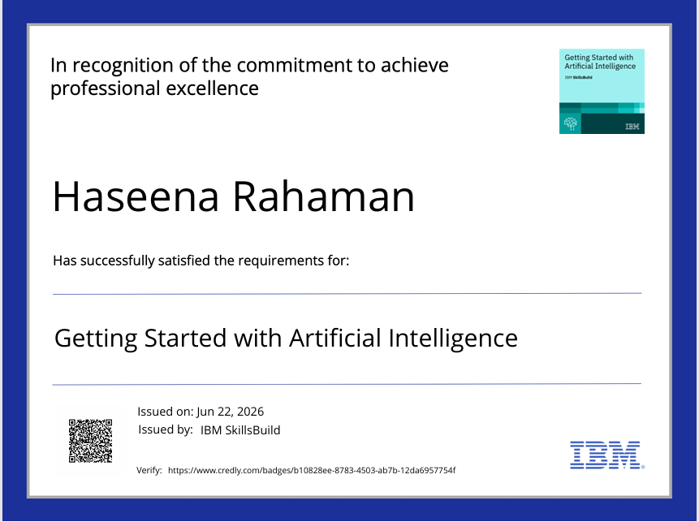
Certificates Earned:

Slide 19
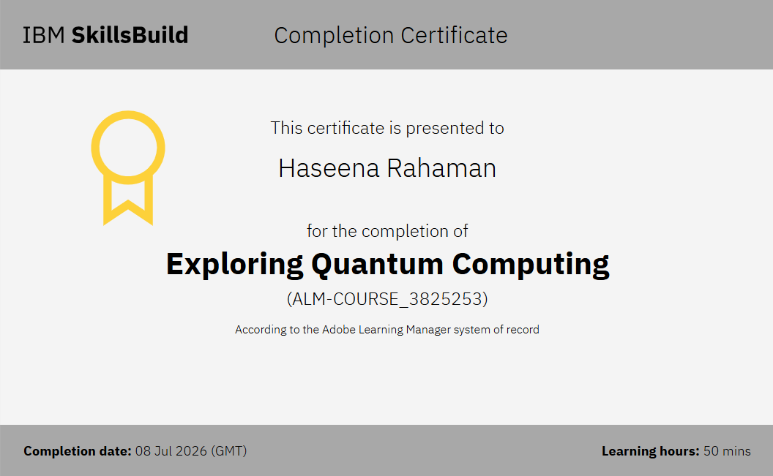
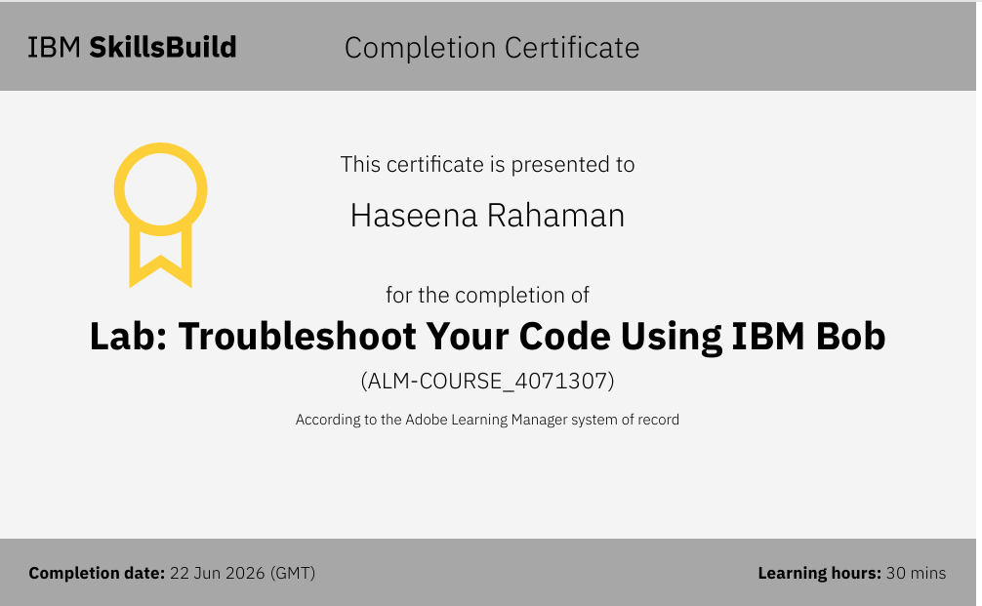

Slide 20
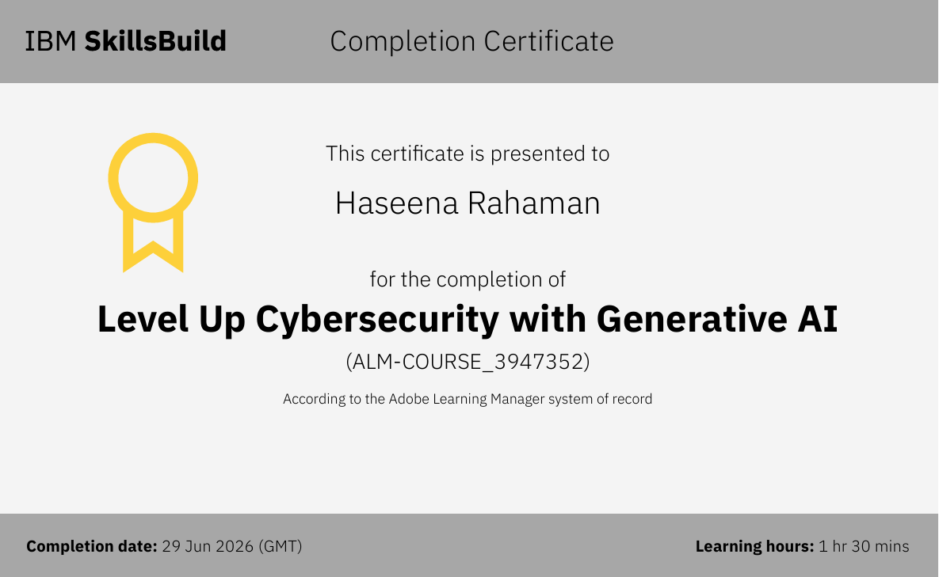
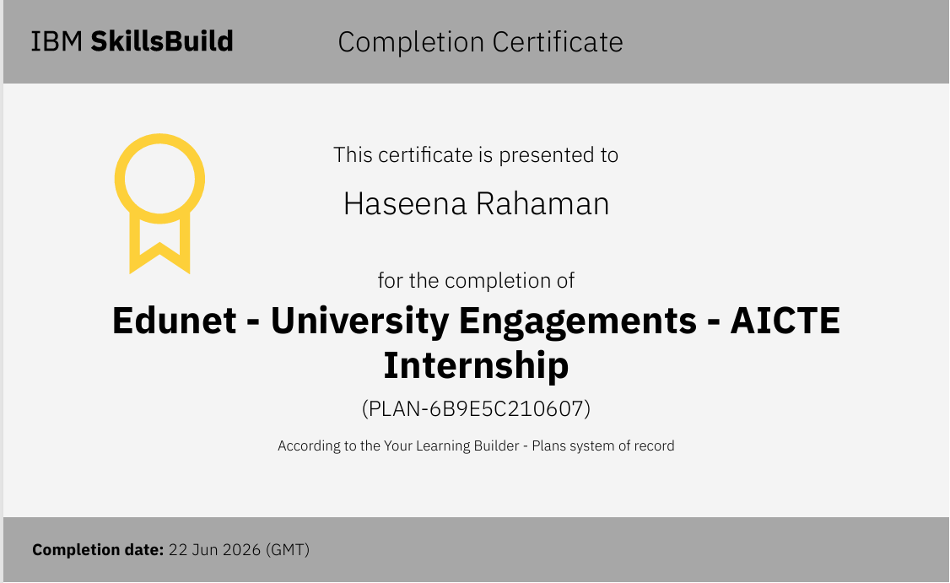

Slide 21


